Slide 1
DATA MINING FOR STOCKS PREDICTION
WQD 180077
ZHU TING
video link : https://youtu.be/BmGc6KciNnc

Slide 2
GOALS
Estimate Next Day Stock Price UP/ Down
In relation to
price history
major Indices
Text sentiments
Exchange rates (MYR-USD)
Covariance Analysis

Slide 3
DATA PROCESSING
In our assignment which we using two dataset
First dataset which we used to calculate PCA
Second dataset which we calculate SAX and PAA( time-series data )
Data preprocessing
a Create a sum column at the right known as “ Total” to sum all the stock values.
b Remove rows with sum value
c Replace NA with 0.000 in dataset

Slide 4
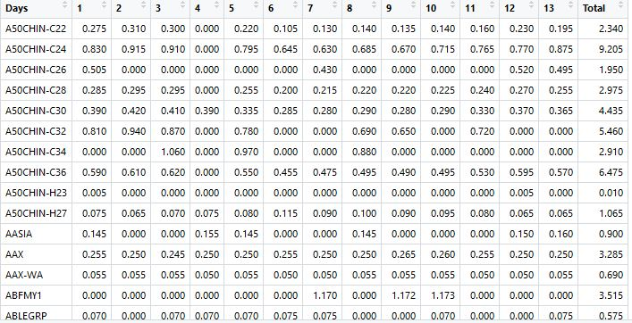
DATASET
The dataset which it contains in 1-13 column in the stock value for each day .The column named “Total” is the sum of all stock values from day 1 to day 13

Slide 5
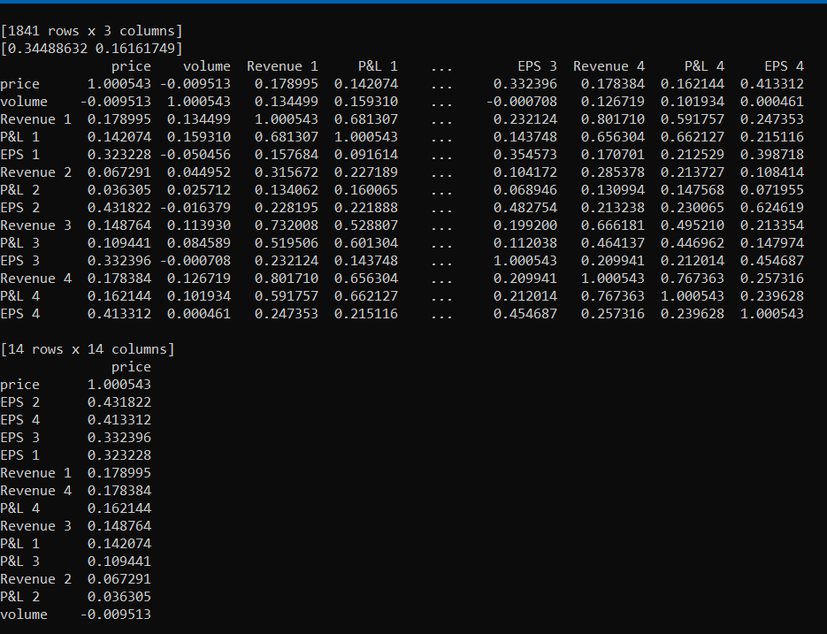
Covariance
Covariance calculations are used to find relationship between dimensions in high dimensional data set.
The positive value of covariance indicates the both dimensions increase or decrease. And negative value indicates while one increase another one do the vice-versa.

Slide 6
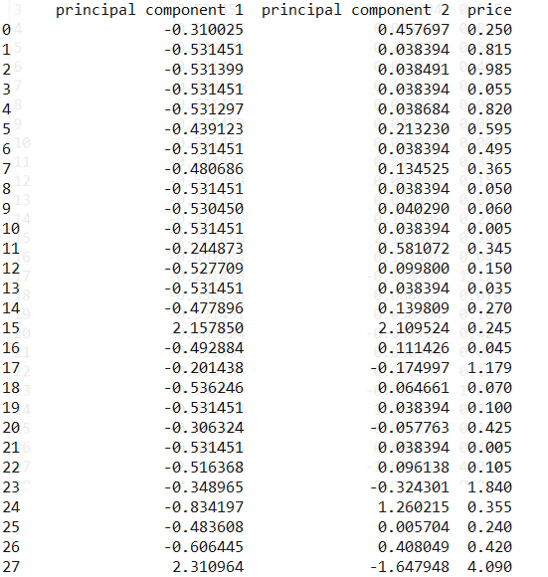
PCA
PCA is a dimensionality reduction algorithm where new features are created which represents the original feature dimensions

Slide 7
The dataset used for PCA is the first dataset-ss.csv.
The feature for PCA calculations for this assignment are Volume , Revenue 1, P&L 1, EPS 1, Revenue 2, Revenue .
Volume refers to buy and sales volumes of the day

Slide 8
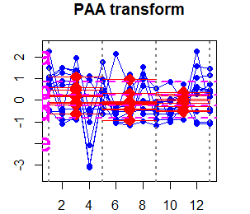
Visualisation
SAX transform strings through 3 PAA points for AASI A.
SAX distance is calcuted by the adding the gap distance between each PAA points in the Y-axis.

